Slide 1
Health Awareness and Nutrition
Department of Clinical Nutrition and Dietetics College of Health Sciences
Lecture 3: Carbohydrates

Slide 2
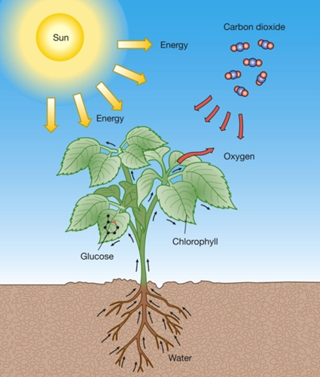
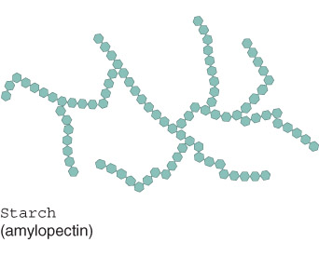
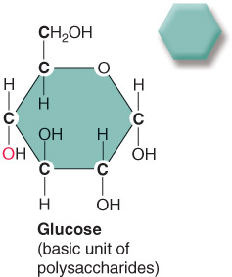
What are carbohydrates (CHO)?
Molecules
Carbon
Hydrogen
Oxygen
Formed by plants via photosynthesis
Stored in plants as starch

Slide 3
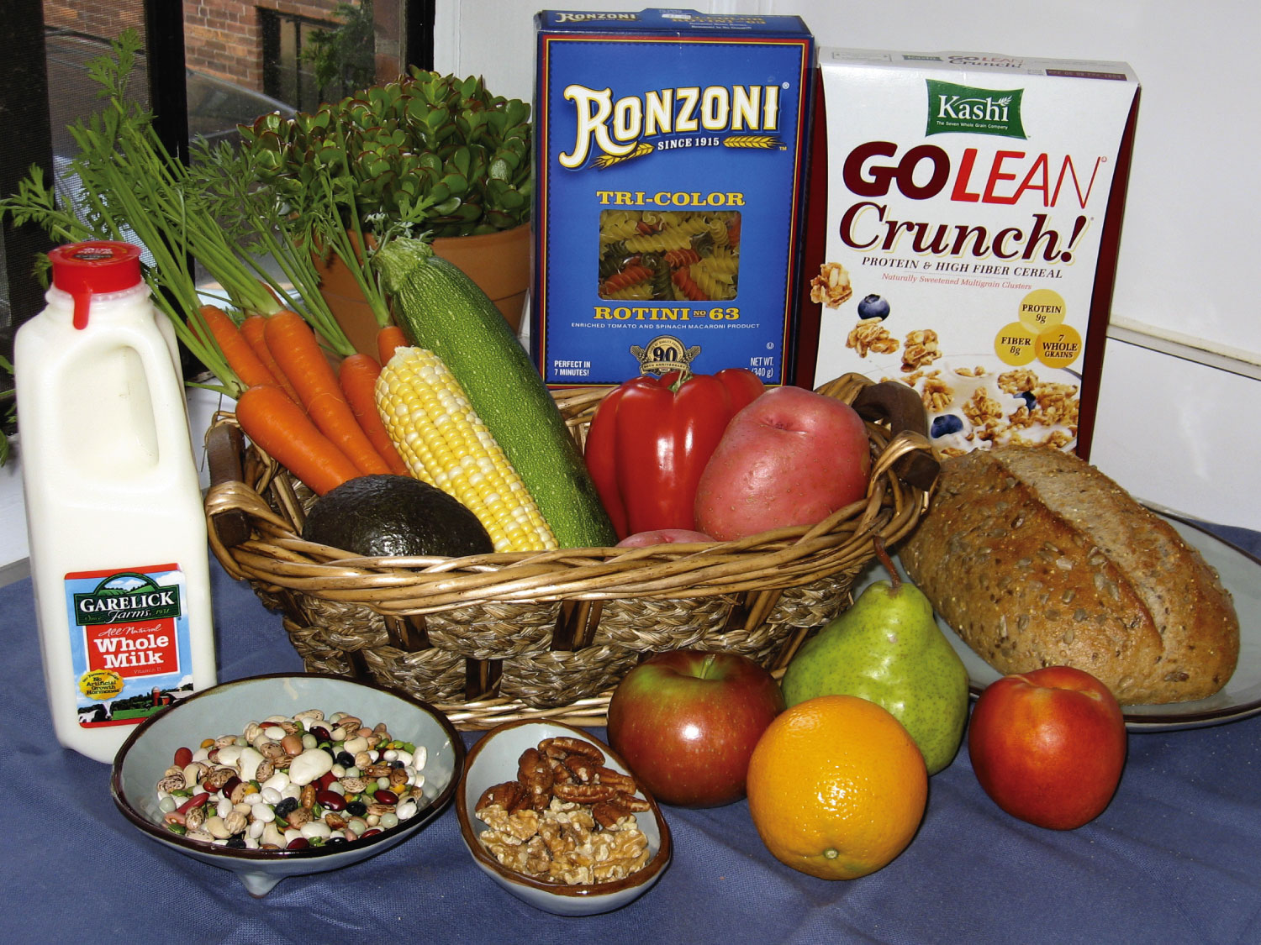
Carbohydrates are found in a wide variety of foods including breads, cereals, pastas, beans, fruits, vegetables, milk, and nuts.
CHO are widely available, low in cost, easily grown and easy to be stored for a long time as compared to many other food items

Slide 4
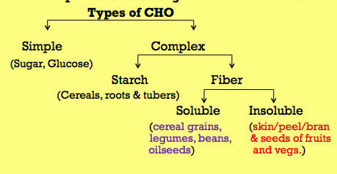
Classification of CHO
CHOs can be classified according to their complexity (the number of sugar units making up their structure)

Slide 5
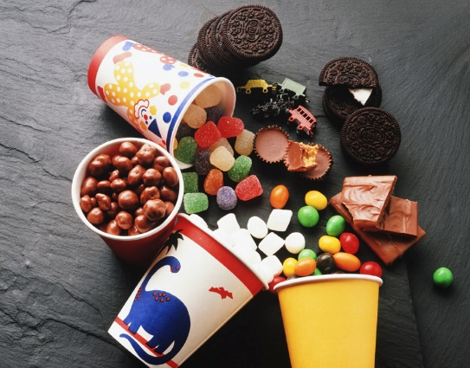
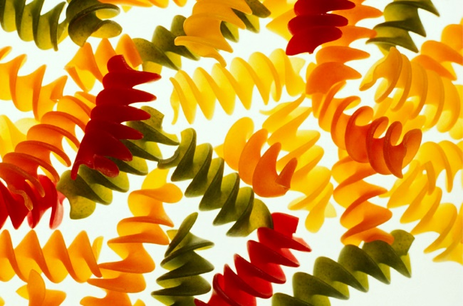
CHO Classification
Simple CHOs
Monosaccharides
Disaccharides
Complex CHOs
Polysaccharides

Slide 6
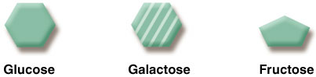
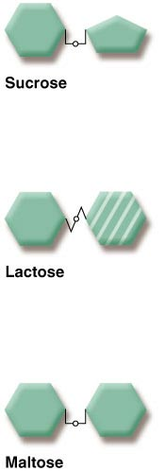
Simple Carbohydrates
They consist of just one or two molecules.
Examples include: sugars, and candies
Monosaccharides: 1sugar unit
Require no digestion, are directly absorbed
Glucose
Galactose
Fructose
Disaccharides: 2 sugar units
Sucrose
Lactose
Maltose

Slide 7

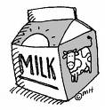
Disaccharides
Disaccharides (Sucrose, maltose and lactose)
Require little digestion (to give glucose)
Sucrose: is broken down to glucose + fructose (Common table sugar)
Lactose: is broken down to glucose + galactose (Main milk sugar)
Maltose: is broken down to glucose + glucose (Found in starches)

Slide 8
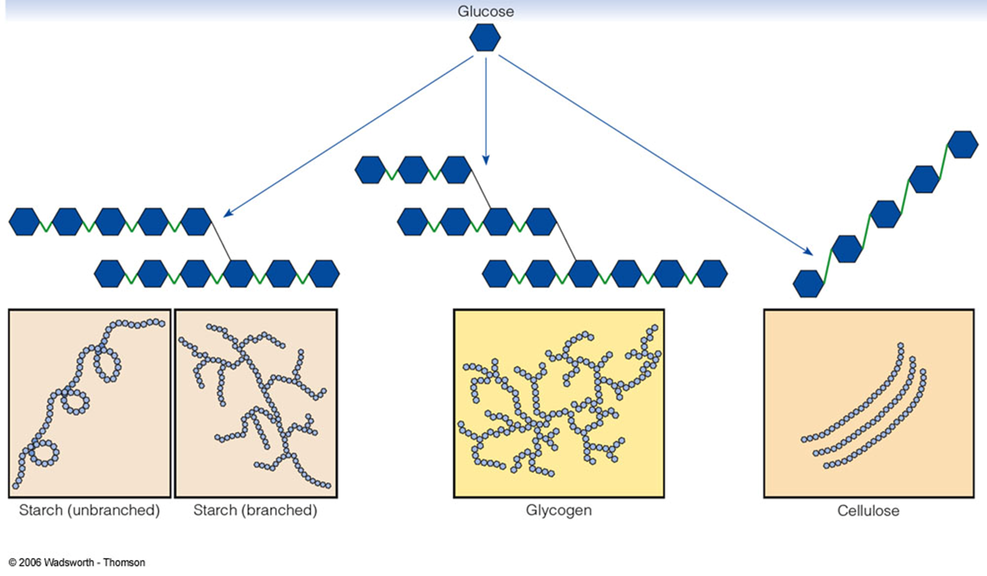
Complex Carbohydrates Polysaccharides
Polysaccharides are chains of many sugars.
They can consist of hundreds or thousands
of monosaccharides.
They act as food stores for plants and animals.
Need to be broken down (digested) into smaller units (glucose) before being absorbed.
Examples include fruits, vegetables, beans, and whole grain pasta
glycogen: which stores energy in the liver and muscles
starches: which are abundant in potatoes, rice, and wheat
Fiber :one of the main structural components of plants

Slide 9
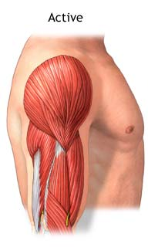
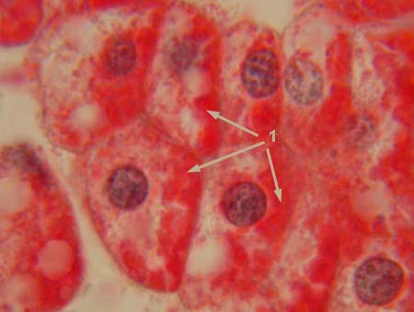
Polysaccharides
Glycogen:
Similar in structure to starch
is the form of storage of CHO in humans and animals.
Glycogen is made and stored primarily in the cells of the liver and the muscles
Glycogen used by the muscle

Slide 10
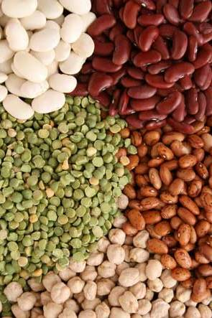
Polysaccharides
Starch:
It consists of a large number of glucose units
It is produced by all green plants as an energy store
It is the most common carbohydrate in the human diet (potatoes, wheat, maize, rice)
It gets converted into glucose
Fibers
Not digested by the body
Main sources are fruits, vegetables, legumes and whole grains
Cellulose, Hemicelluloses, Pectins

Slide 11
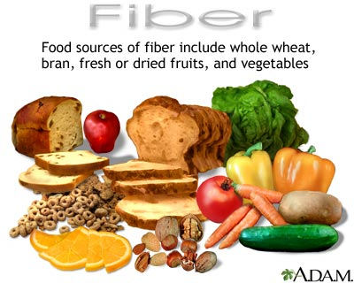
Fibers
Two types of fibers:
Soluble fibers
Viscous (thick consistency due to their solubility in water)
Fermentable :It is fermented in the large intestine into gases and active byproducts; used as feed for the bacteria in the gut- (prebiotic)
Food Sources: oats, fruits, vegetables, legumes
Health Benefits:
Slow gastric emptying time → give a feeling of satiety
Help reducing glucose and cholesterol levels in the blood

Slide 12
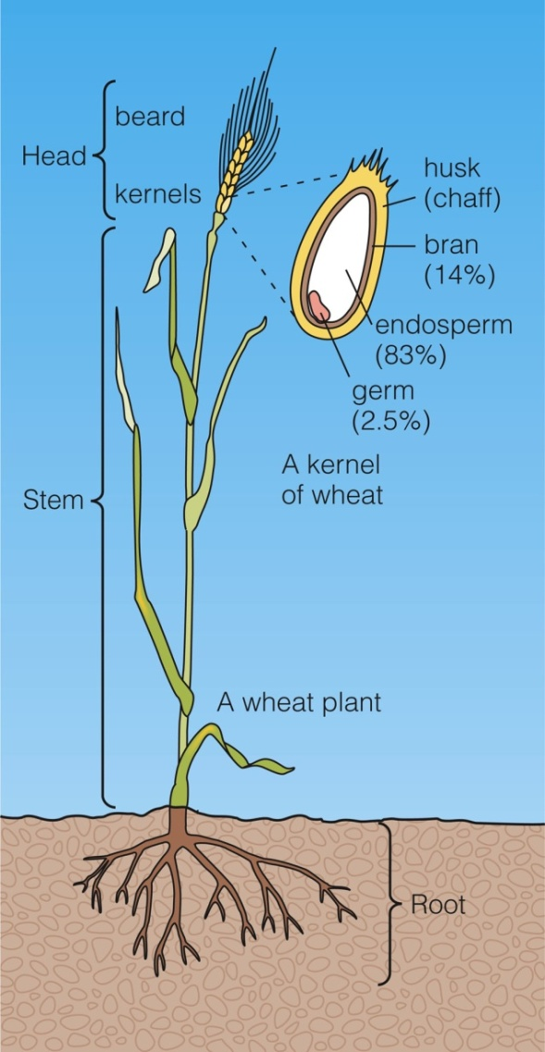
Fiber
Insoluble fibers
Non-viscous (due to insolubility in water)
less fermentable & aid the digestive system by easing elimination and alleviating constipation
• Food sources: whole grains, skins of fruits and vegetables
Health benefits
Increase bulk → soften stool
prevent constipation

Slide 13
Fiber
Important information:
If the diet is high in fibers, it is the potential for significant intestinal gas production and bloating
When you add fiber you should also include more fluids
Constipation can occur if insufficient fluid is consumed with a high-fiber diet
Excess intake of fibers is not very appreciated as they can reduce the absorption of certain vitamins and minerals

Slide 14
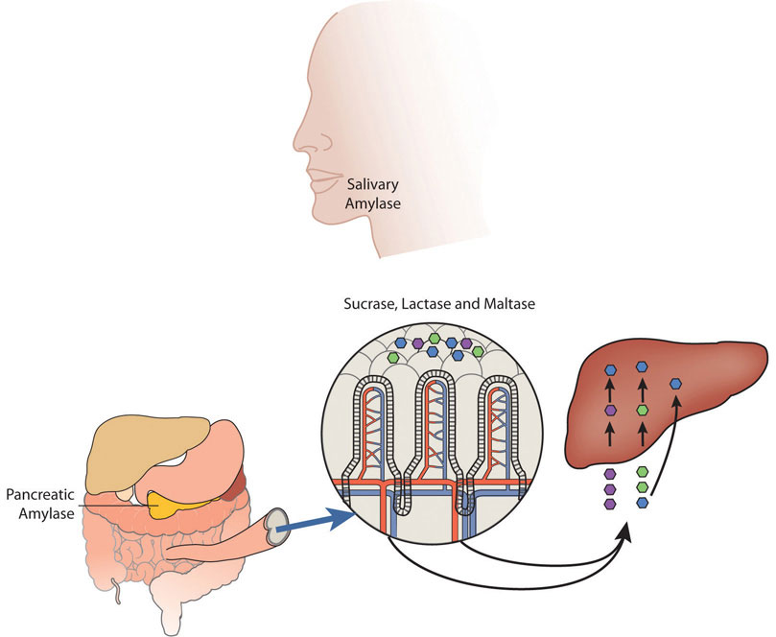
Digestion of CHO
The digestion of CHO starts in the mouth with the help of salivary amylase.
Carbohydrate digestion continues in the small intestine: pancreatic amylases breakdown the CHO into a simpler form
End products of carbohydrate digestion:
Glucose, fructose, galactose
Absorbed into bloodstream
Fibers are not digested, they are excreted in feces

Slide 15
Functions of CHO
Energy source
Glucose:
Basic simple sugar in body metabolism
1 gram of CHO gives 4 kcals
Primary energy source for the body
Adequate carbohydrate intake spares proteins for their prime function of growth & maintenance
Energy source for the cells of the Central Nervous System and red blood cells

Slide 16
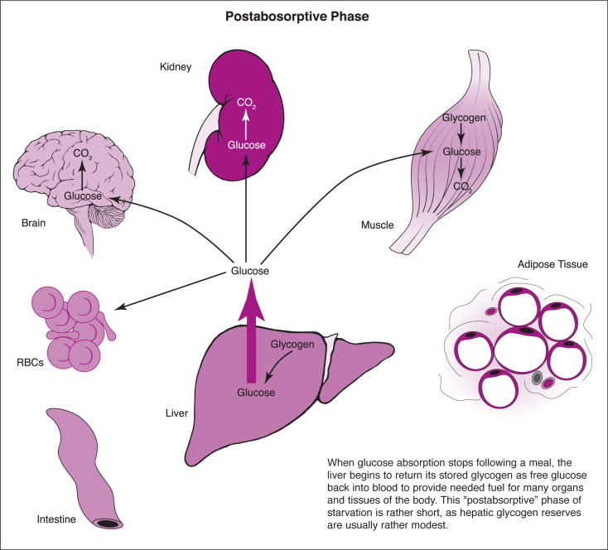
Routes of blood glucose
Used for energy
Excess is converted to liver or muscle glycogen
Excess is converted to and stored as fat in adipose tissues

Slide 17
Carbohydrate Recommendation
Recommended Dietary Allowances for carbohydrates:
Minimum 130 g/day
45% - 65% total daily energy intake
For Fibers
RDA is 25 to 35g/day. (depends on food intake and gender)

Slide 18
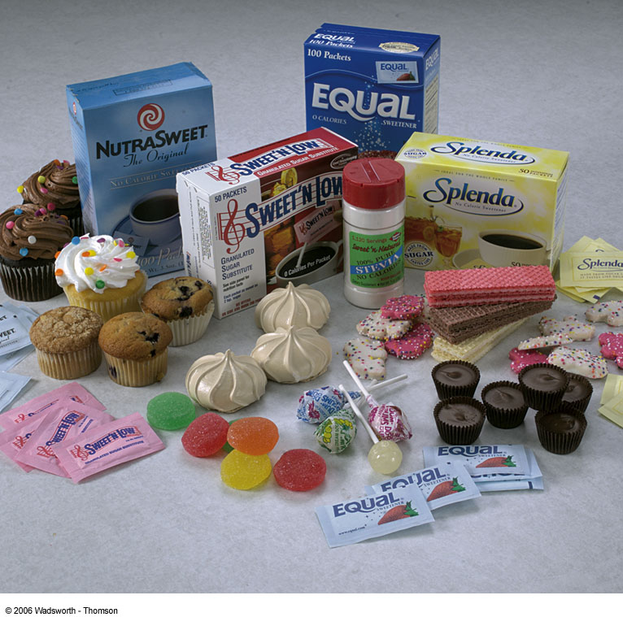
Artificial sweeteners
Generally sweeter than sucrose
Artificial sweeteners and other sugar substitutes are found in a variety of food and beverages marketed as "sugar-free" or "diet," including soft drinks and baked goods.
They are all calorie free
These substances are harmful if consumed in high doses but the FDA has approved their consumption within the acceptable doses.

Slide 19

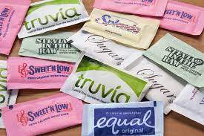
Artificial Sweeteners
Saccharin
Sweet’N Low
Sugar Twin
Aspartame
NutraSweet
Equal
Acesulfame-K
Sunett
Sweet One
Sucralose
Splenda
Cyclamate
Stevia
Truvia
Sweetleaf

Slide 20
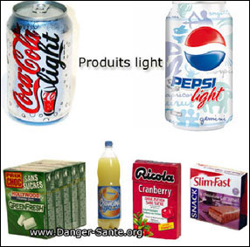
Artificial Sweeteners
Aspartame:
Is a type of artificial sweetener
It is mainly used in all diet soft drinks and beverages
200 times sweeter than sugar

Slide 21
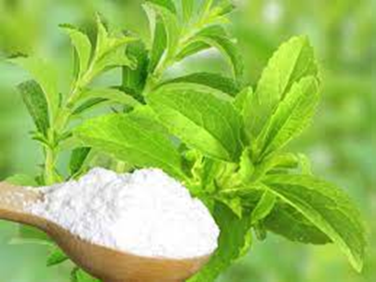
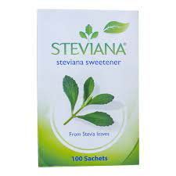
Artificial Sweeteners
Stevia
Stevia is a sugar substitute made from the leaves of the stevia plant.
It’s about 100 to 300 times sweeter than table sugar, but it has no carbohydrates, calories, or artificial ingredients.

Slide 22
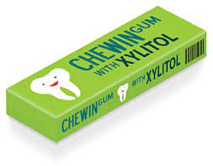
Sugar alcohols
Sugar alcohols are sweeteners that have about half the calories(upto 2 kcal/g) of regular sugar.
They occur naturally in certain fruits and vegetables, but some are man-made and are added to processed foods.
Many foods labeled "sugar free" or "no sugar added" have sugar alcohols such as: chewing gum, baked goods, and sweets
Are not broken down by oral bacteria, hence do not cause dental caries
Eg: xylitol, mannitol, sorbitol etc.

Slide 23
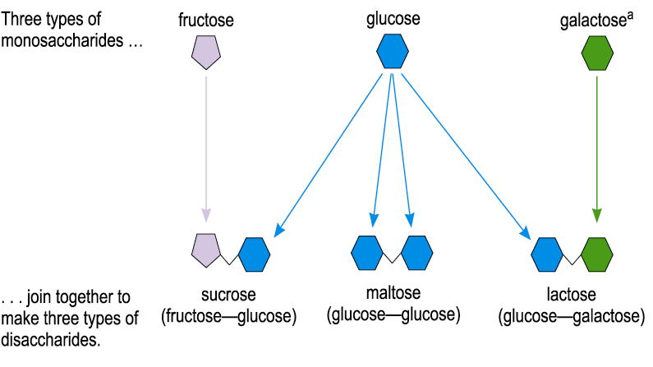
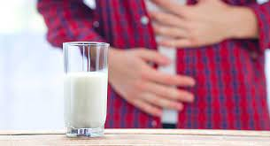
Lactose intolerance
Is the inability to digest lactose in milk and dairy products
Causes:
A disorder characterized by the deficiency of the digestive enzyme lactase that splits the lactose disaccharide into galactose and glucose
Symptoms
It begins ½ - 2 h after eating or drinking milk or milk products and may result in: pain or cramps in the lower abdomen, excessive gas (flatulence and bloating), diarrhea (sometimes the stools are foamy)

Slide 24
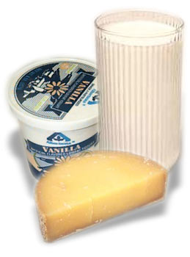
Lactose intolerance
What can I eat if I have lactose intolerance?
Many people can tolerate as much as a one cup or two of milk a day
Almost all humans lose some of their ability to produce lactase as they age
Foods to avoid would be milk and all food containing milk (cream or white sauce)
Alternatives include
Cheese, Yogurt

Slide 25
Info for your interest

Slide 26
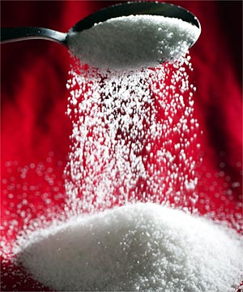

Tips to improve the sweetness of foods without boosting their calories:
Serve sweet foods warm (heat enhances sweet tastes)
Add sweet spices such as cinnamon, nutmeg,
Try reducing the sugar added to recipes by one-third
Select fresh fruit or fruit juice or those prepared without added sugar
Use small amounts of sugar substitutes instead of sucrose

Slide 27

Classification of CHO

Slide 28
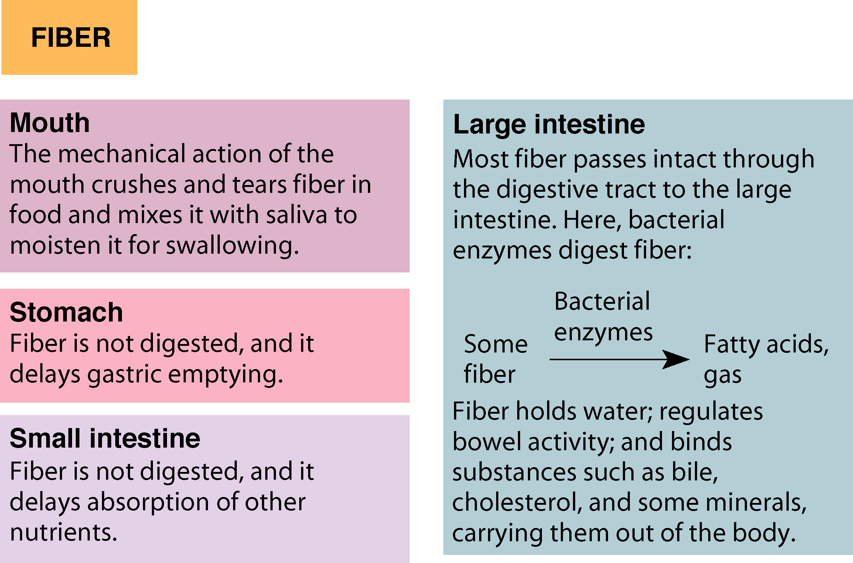

Slide 29
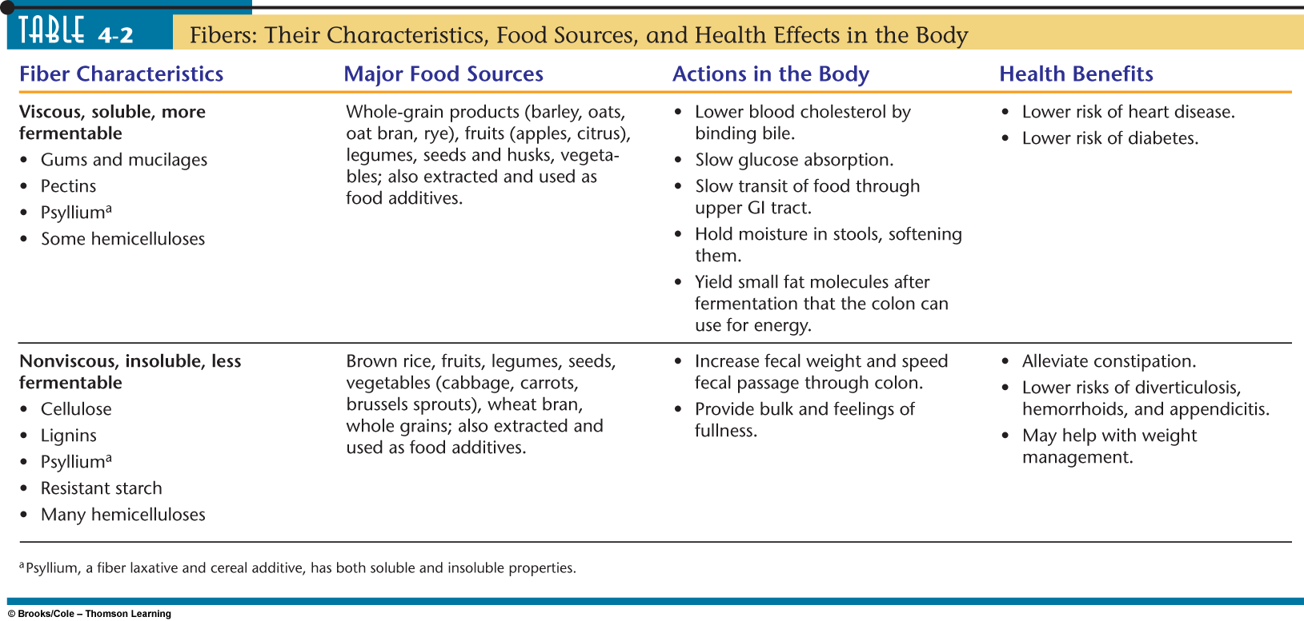

Slide 30
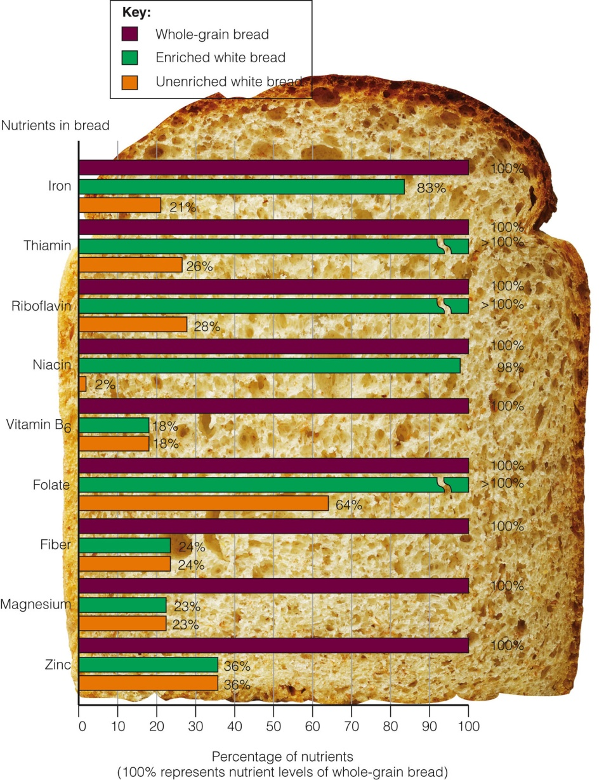

Slide 32
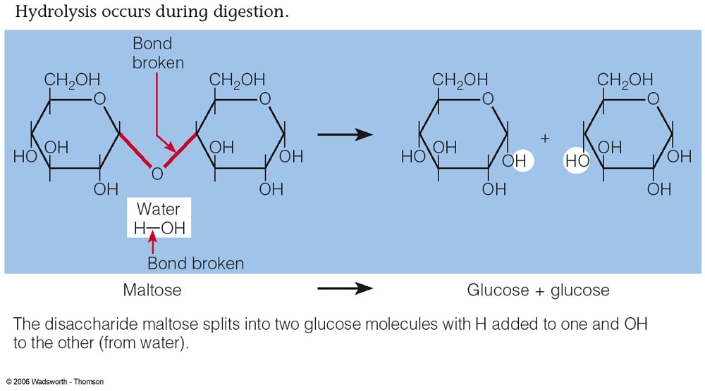
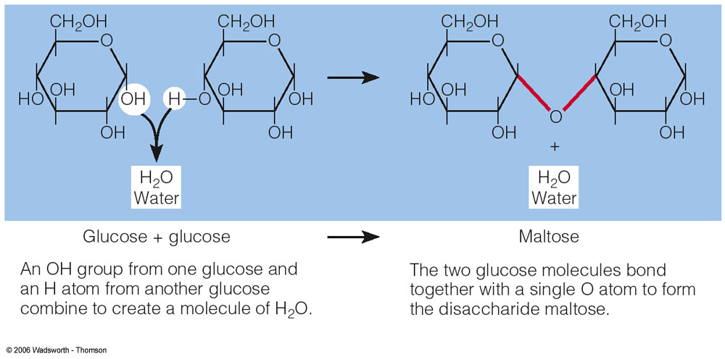
Conversion between Mono & Disaccharides

Slide 33
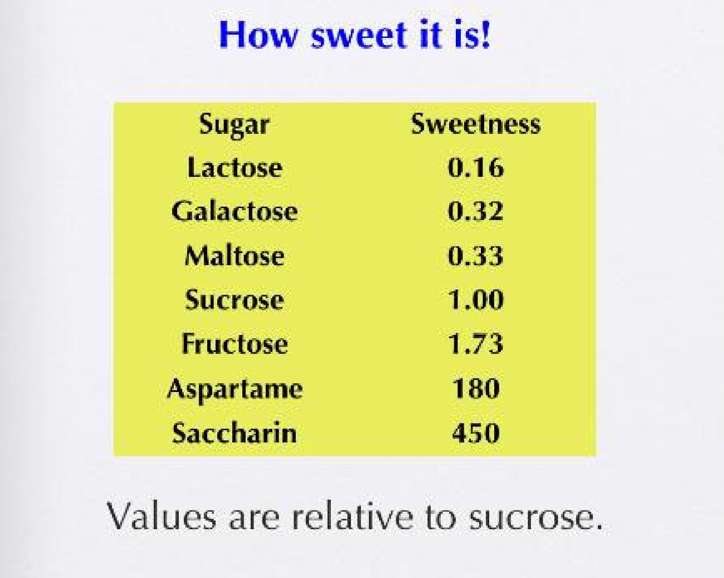

Slide 34

DRI FOR CHO
The DRI for CHO is 45-65% of daily calories
Min. 130 g/day for adults & children
Food intake from CHO should be mainly of starch (complex CHO)with a minimal intake of simple sugars.

Slide 35
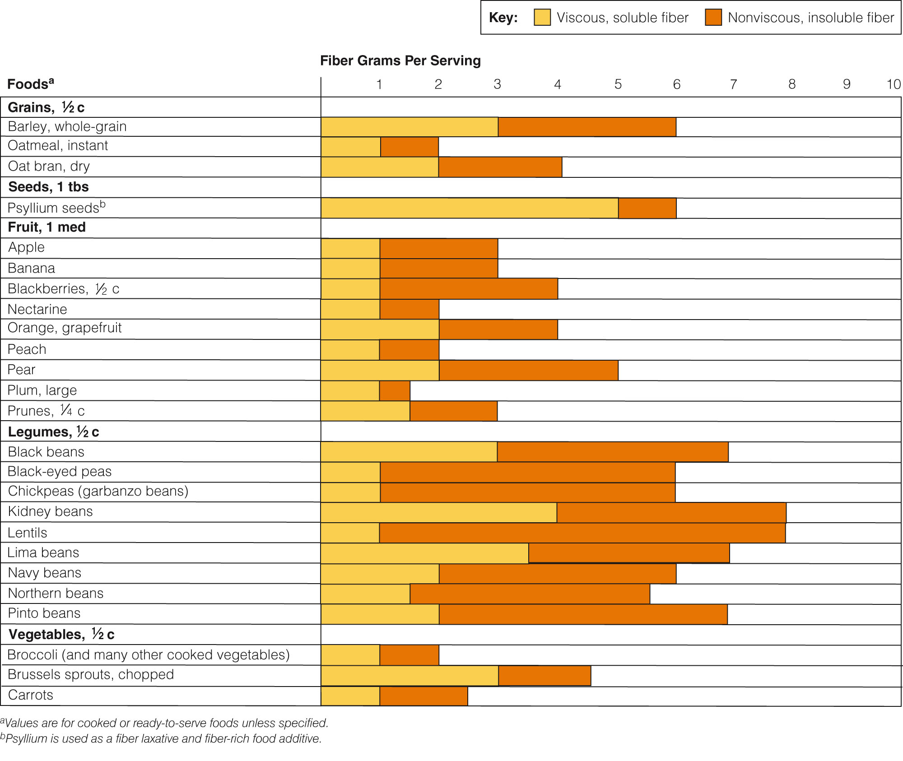

Slide 36
